Slide 1

TinyTender: Crying Baby Detection and Phone Notifications
TEAM MEMBERS:
SWEATHA.K.M [210421121051]
BHARATHI PRIYADHARSHINI.T [210421121008]
JEEVAVARSHA.V [210421121023]

Slide 2
PROBLEM STATEMENT
Newborns used to communicate by crying. This way the newborn expresses his/her physical and emotional state and his/her needs.
To detect whether a baby is crying, when a person is not near the baby, this system is established.
The primary goal is to help Parents to Guard the baby when they are in work.
The overall objective is to send signals to Caregivers via an LED device, enabling them to respond to the baby’s needs.
The Successful implementation of this proposed system will provide the parents with a valuable tool to enhance the safety.

Slide 3
LITERATURE REVIEW
Sl. No | Title of the Paper | Authors | Name of the Journal, Year, Volume, Issue | Observation
1 | Baby cry recognition in real-world conditions | Horia Cuc, Dragos Burilean, Andi Buzo | ResearchGate jounal, 2016, By Polihnica of Bucharest, Romania. | In this paper, it is propose a fully automatic system that attempts to discriminate between different types of cries. The baby cry classification system is based on Gaussian Mixture Models and i-vectors.
2 | BABY CRADLE MONITORING AND CONTROL USING ARDUINO | DELIPKUMAR.V,JAYALAKSHMY .S | International Journal of Information and Computer Science, Volume 6, Issue 3. | This paper manages structure and execution of Baby Cradle Monitoring and Control which is uncommon blessing to guardians in this century. The goal of this paper is to structure a keen child support with numerous highlights.
3 | Rock Me Baby: The Automatic Baby Rocker” | Steven Bang; Richard Lam; Natallia LoCicero. | San Jose State University, May 17, 2011. | The project idea develops from the fact that a woman finds it difficult to concentrate on her child owing to her busy schedule of house life.

Slide 4
LITERATURE REVIEW
Sl. No | Title of the Paper | Authors | Name of the Journal, Year, Volume, Issue | Observation
4. | Design of Noise Level Monitoring Based On Arduino Uno | Laura Anastasi Seseragi Lapono, Redi Kristian Pingak | Conference paper at research gate , October 2018, UNDANA PRESS publications. | This research aims to know the noise level monitoring. The data acquisition system consists of an analog sound sensor V2, Arduino Uno, display LED, and display seven segment
5 | Internet of Things and Nodemcu A review of use of Nodemcu ESP8266 in IoT products | Yogendra Singh Parihar | 2019, JETIR June 2019, Volume 6, Issue 6 | The prototype is the first, step in building an Internet of Things(IoT) product. An IoT prototype consists of user interface, hardware devices including sensors, actuators and processors, backend software and connectivity.
6 | Automatic Detection of Baby Cry using Machine Learning | Varsha Dange, Tejaswini Bhosale | Ijraset Journal ,2013 | In this proposed model, a baby’s cry is being detected and a music player will be played after detection in order to create a soothing environment for the baby.

Slide 5
LITERATURE REVIEW
Sl. No | Title of the Paper | Authors | Name of the Journal, Year, Volume, Issue | Observation
7 | Predicting the Reason for the Baby Cry Using Machine Learning | Chaithra lakshmi C*, Aravinda B, Deeksha, Deeksha, Sadhana | Journal of Artificial Intelligence, Machine Learning and Soft Computing, Volume 4, Issue 1 | This paper proposes the system to predict the reason for the baby cries using machine learning.
8 | Application of deep learning for recognizing infant cries | Chuan-Yu Chang ; Jia-Jing Li. | 2016 IEEE International Conference on Consumer Electronics-Taiwan (ICCE-TW) | A convolutional neural networks (CNN) based deep learning is then adopted to train and classify the crying into three categories including hungry, pain, and sleepy. Experimental results shows that the proposed method achieves high classification accuracy.

Slide 6
LITERATURE REVIEW
Sl. No | Title of the Paper | Authors | Name of the Journal, Year, Volume, Issue | Observation
9 | IoT-Based Autonomous Baby Monitoring System Using Mobile App Control | Chung, G.C., Teong, K.V., Tan, S.F., Sundarajoo, R.A. | Part of the Lecture notes in Electrical Engineering book series (LNEE, volume 835) | In this paper, we propose to develop a long-ranged baby monitoring and controlling system. The system consists of hardware architecture that is inter-connected with an IoT network to monitor the real-time condition of the baby.
10 | Deep Learning Assisted Neonatal Cry Classification via Support Vector Machine Models | Ashwini.K, Durai Raj Vincent, Kathiravan Srinivasan, Chuan-Yu Chang | ORIGINAL RESEARCH article. Public Health, 10 June 2021 Sec. Digital Public Health Volume 9 - 2021 | | This work mainly discriminates the neonatal cries into pain, hunger, and sleepiness. The deep convolutional neural network (DCNN) technique takes the spectrogram images for input.

Slide 7
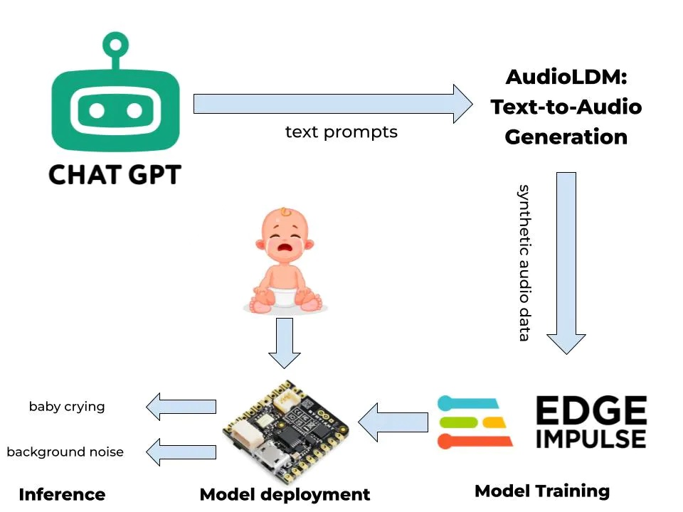
EXISTING SYSTEM

Slide 8
PROPOSED SYSTEM
The system is capable of detecting the crying of the baby, and immediately notify the user.
Then the music system automatically pops up and makes the baby sleep when the parents are not around.
The parents can monitor the real-time status of the baby through the mobile application within the same network.
The mobile app is designed to help parents or caregivers quickly respond to their baby's cries, which will be implemented later in the future.

Slide 9
WORKING
Audio Monitoring: The system continuously monitors the audio in the baby's room.
Sound Detection: When the system detects a sound level above the set threshold and identifies it as a baby crying based on the sound analysis algorithm, it triggers a response.
Notification: The system notifies by alerting the parent by with an Indicator.
Music Playback: Simultaneously, the system selects soothing music based on the algorithm and starts playing it through the speaker system in the baby's room.

Slide 10
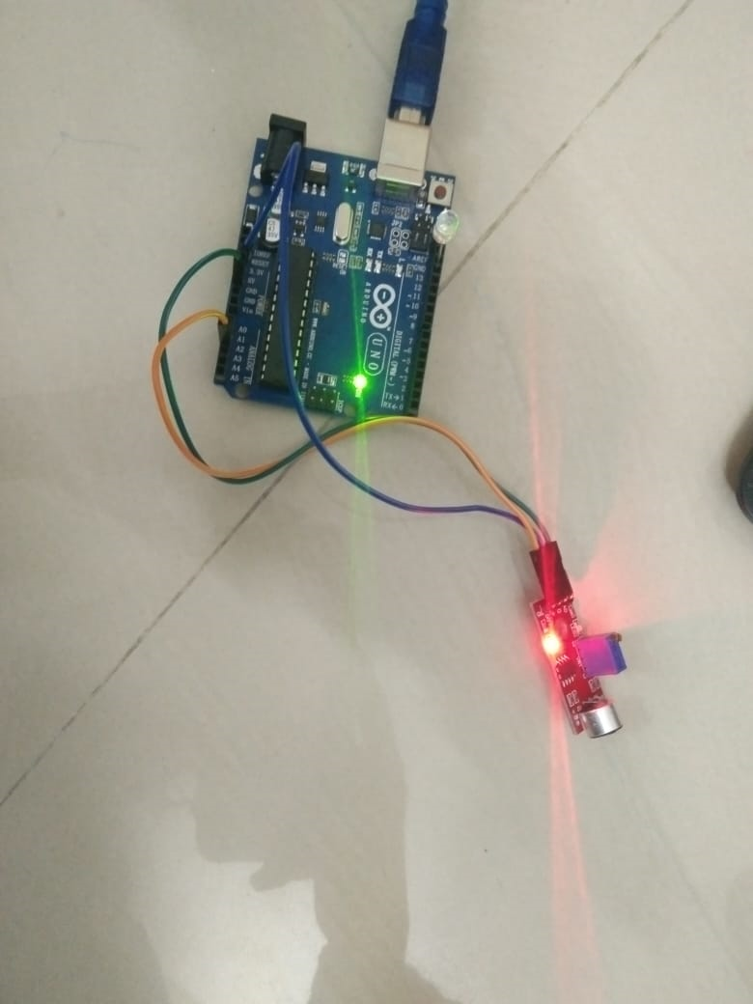
PHOTOSNAP OF PROJECT

Slide 11
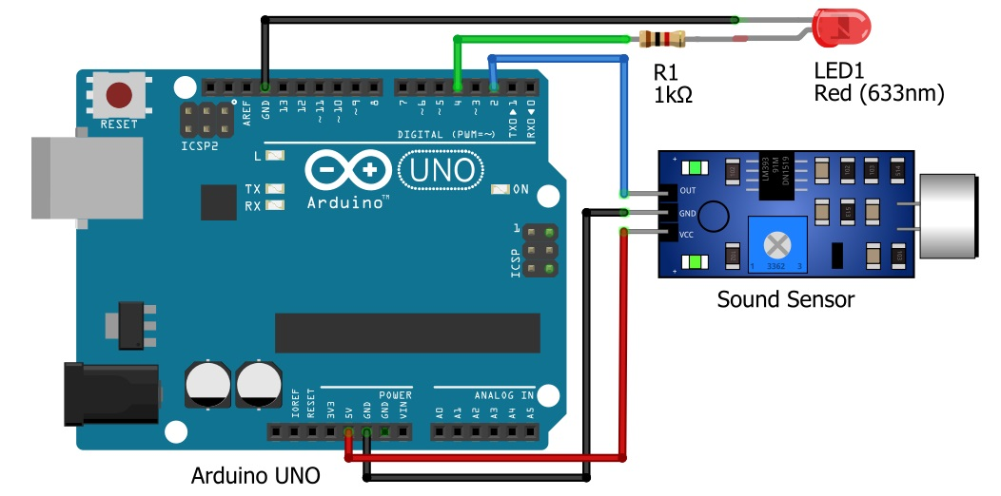
CIRCUIT DIAGRAM

Slide 12
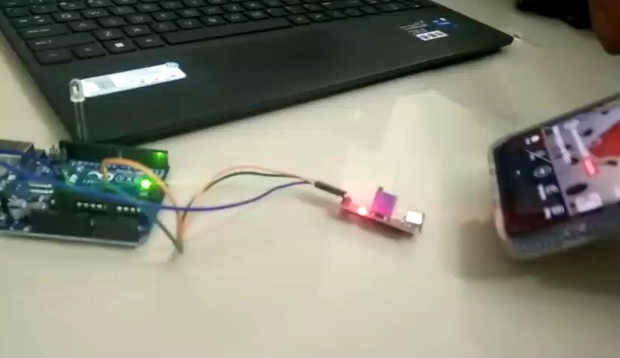
WORKING VIDEO OF PROJECT
https://drive.google.com/file/d/1gPs-FBufZppySzfvfF7y-1nsiN_GunNd/view?usp=drivesdk

Slide 13
RESULT AND DISCUSSION
The Tiny Tender project predicts the baby cry sound with the minimum frequency of 250Hz to the Highest of 650Hz.
The specific frequency of a baby's cry can vary depending on various factors, including the baby's age and their individual vocal characteristics.

Slide 14

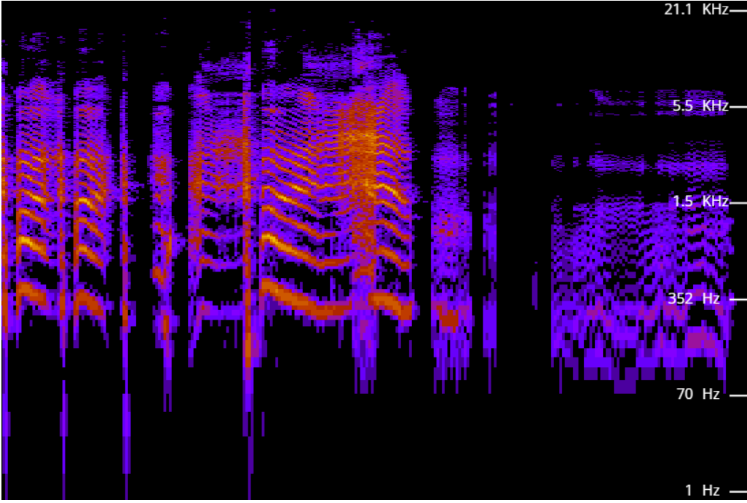
GRAPH
The Sample Baby Cry sound -

Slide 15
APPLICATION
Sound Detection Library- Spectrum analyser
Music Playback: - Media Player Libraries
IoT Integration with Arduino
Documentation: Microsoft Word

Slide 16
FUTURE WORK
In our Cry Baby Notification system, the Automatic Swing of the cradle will be included.
We tend to Detect the Type of Baby Crying and Identify the cause of the crying.
With the successful detection of the Type of the Cry, Suitable Music will be played to Calm down the Baby, until the Parent/Guardian arrives.

Slide 17


